Slide 1
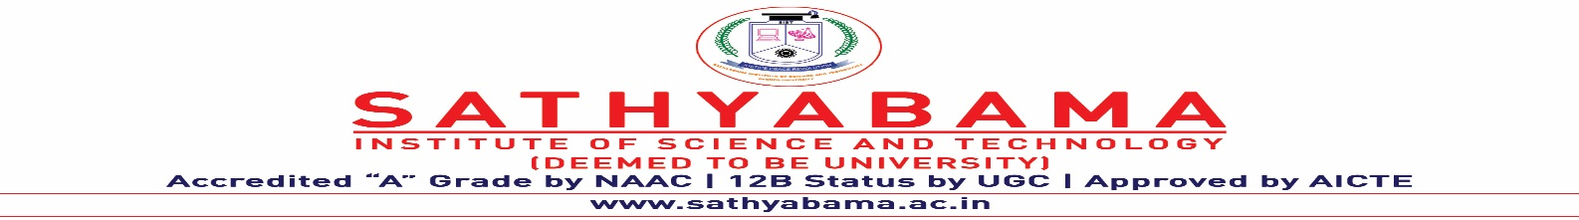
PORTABLE CAMERA BASED IDENTIFICATION SYSTEM FOR VISUALLY IMPAIRED PEOPLE
Under the guidance of
Dr. S. Prince Mary, M.E., Ph.D.,
by
Ashveena A
(39110094)
Bala Deepika J
(39110112)

Slide 2
Introduction
A cutting-edge method for designing a set of assistive technology for the blind to satisfy their daily requirements.
To aim at creating a system that helps blind people to get an alarm sensor along with the details of the object found and the distance.
The SSD algorithm is applied for doing the image processing.

Slide 3
Objectives
To work as an aid for visually impaired people.
To visualize the visual in front of them at their convenience.
To prevent any mishap and ensure safety in all possible ways.
To alert the user beforehand.

Slide 4
System Architecture
MOBILE/DEVICE
CAMERA
POWER SUPPLY
ULTRASONIC SENSOR
SPEAKER/MICROPHONE
RASPBERRY PI
RECEIVER
CRYSTAL
OSCILLATOR
TRANSMITTER
IMAGE PROCESSOR/SSD
BUZZER
AUDIONOTE

Slide 5
Experimental Setup
This model works by Capturing stuffs on live camera and updating it to the person using audio text time to time.
This facility combined with the available devices used by them such as the walking cane, or as a head wearable device or a watch could actually add more usage to the discussed subject.
The text navigator device and identification systems are integrated into the single chip which is represented as Raspberry pi ARM11.

Slide 6
Experimental Setup
COCO dataset of 80 classes is used for this purpose.
The Single Shot Algorithm is used for processing the image captured.
The text navigator system is used to convey that text file information using the speaker.

Slide 7
Modules
OBJECT DETECTION USING ULTRASONIC SENSOR:
Utilizing an ultrasonic sensor, an object's presence is found.
It is one that reflects on touching any surface.
The ultrasonic sensor transmits and receives trigger and echo for a certain amount of time using its transmitter and receiver modules.
The procedure begins as soon as the power supply is turned on.

Slide 8
Modules
OBJECT CAPTURISATION USING THE CAMERA:
The placement of a camera allows for the detection of things in the path on the camera's display.
When an object is identified, it starts functioning by giving input to the raspberry pi port in addition to the input of the ultrasonic sensor's detection.
A faster detection rate may be achieved with sophisticated camera solutions.

Slide 9
Modules
CONNECTIONS IN RASPBERRY PI PORT:
The text navigator device and identification systems are combined into a single chip known as the Raspberry Pi.
The image is sent to the raspberry pi port by the camera module that captured it.
The distance calculated using the ultrasonic sensor detection is saved into the Raspberry Pi.
There is also a headphone jack for listening to the output.

Slide 10
Modules
IMAGE PROCESSING USING SSD ALGORITHM:
The camera's acquired image, which the Raspberry Pi accepts as input, is then taken for additional processing.
The SSD algorithm is utilized in this situation because of its capacity for greater accuracy and quicker speed.
COCO dataset abbreviated as Common Objects in Context is made use of.
The output of image processing can either be an image or a set of parameters or characteristics related to the image.

Slide 11
Modules
DISTANCE CALCULATION:
A measurement of how far away the thing is from the blind person is made.
The ultrasonic sensor generates a specific amount of ultrasound in Hertz. It bounces back after getting into contact with an object in a path.
Distance= (Time Elapsed*34300)/2
where, Time Elapsed =Stop Time–Start Time
34300-Speed of Sound

Slide 12
Modules
PRESENTING THE OUTPUT AS VOICE NOTE:
In order to provide the results in an auditory output that is suitable for individuals who are visually handicapped, the text reader system is being utilized.
Python's pyttsx3 library serves to convert text to speech.
The speaker or the headphone has to be connected to the raspberry pi.
When an object comes in contact within 90 inches from the user a buzzer sound is presented indicating it along with the distance.

Slide 13
Results and Discussions
After successful execution of the models we would be able to find the name of the object classified and also along with at what distance it is.
The snapshots of the moving video appear as image one after another on the screen.
The output appears as a text for our reference.
The output is also played in an audio format for the visually impaired people which is the major purpose of our project.

Slide 14
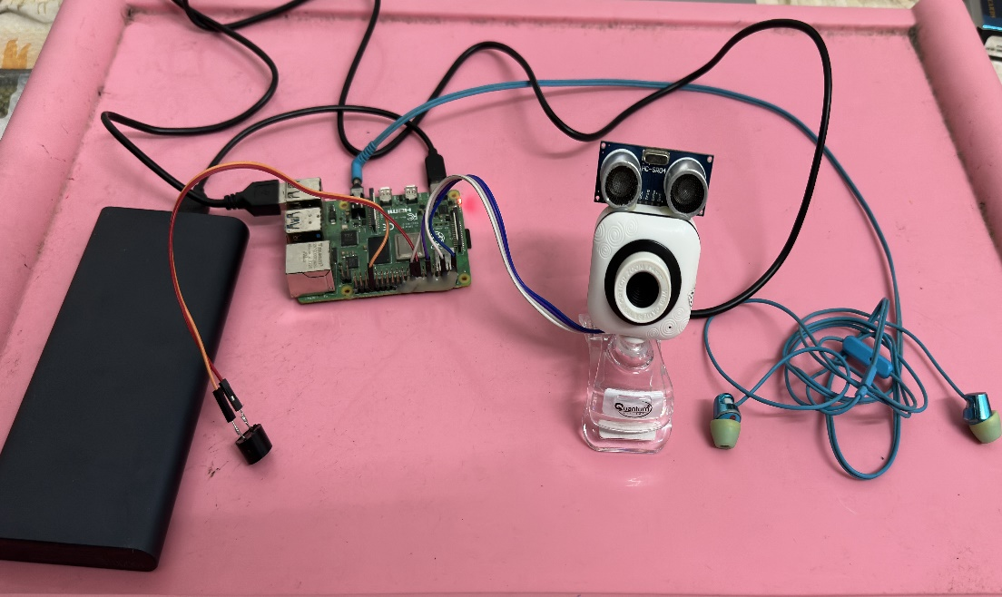
Snapshots
Experimental Setup

Slide 15
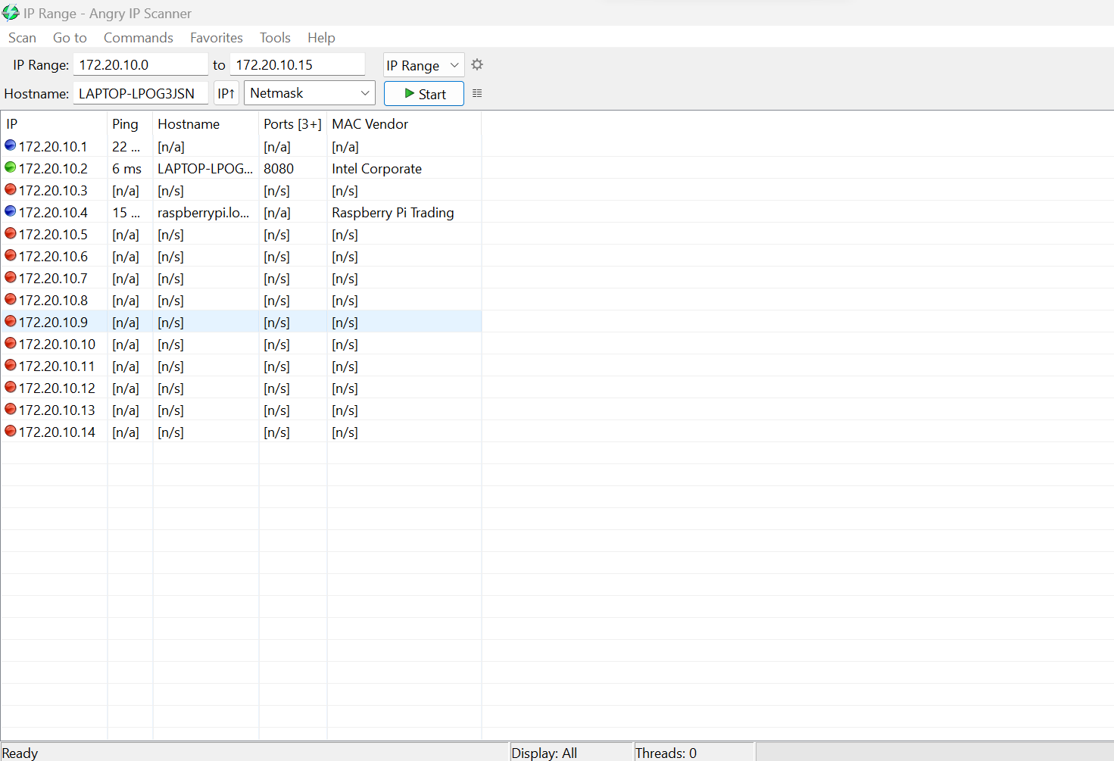
Snapshots

Slide 16
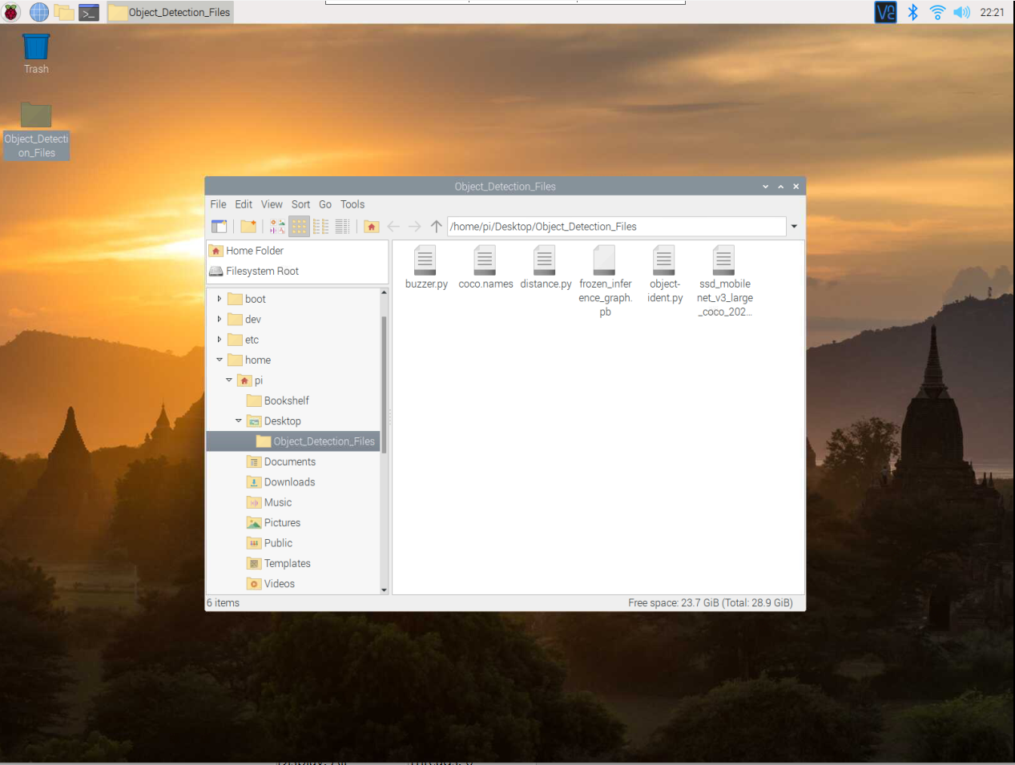
Snapshots

Slide 17
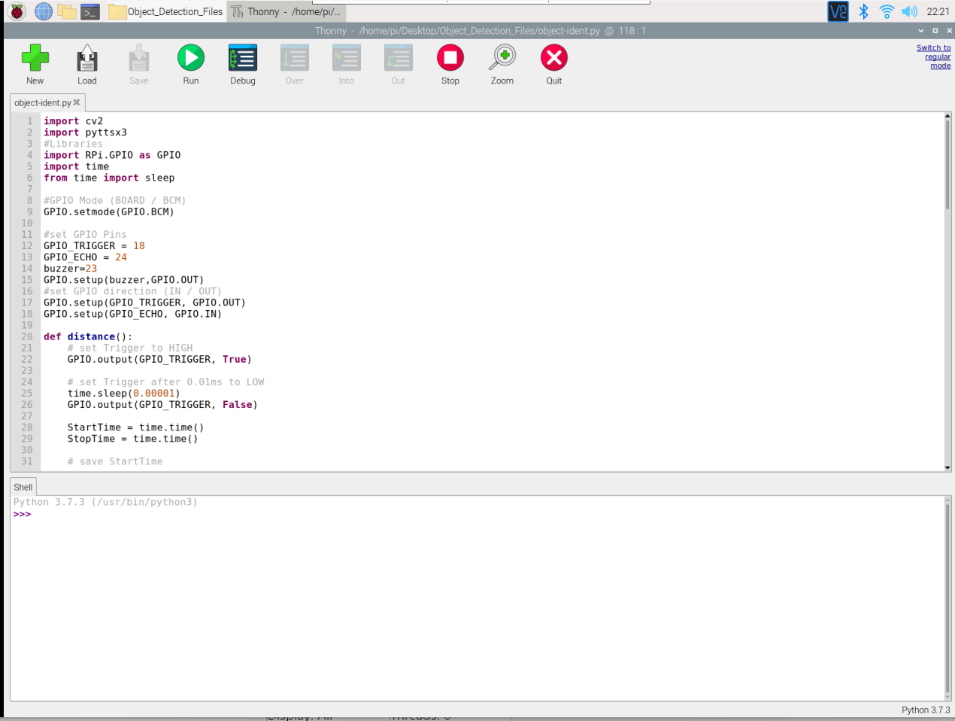
Snapshots

Slide 18
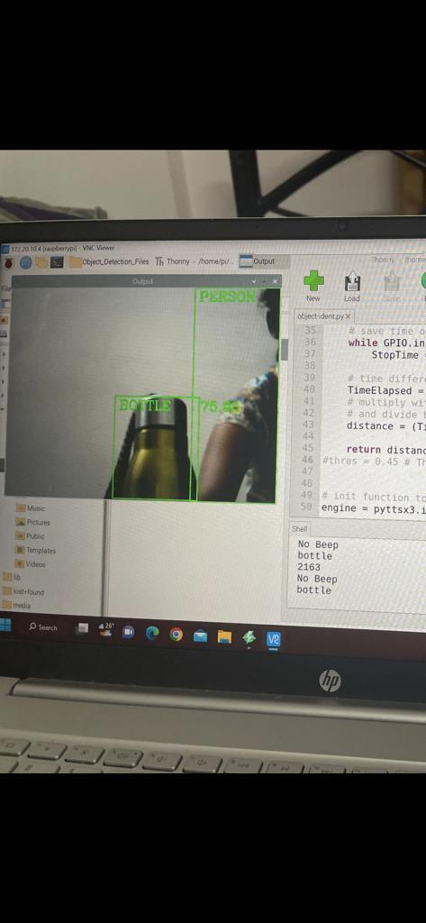
Snapshots
Output of Image Recognition

Slide 19
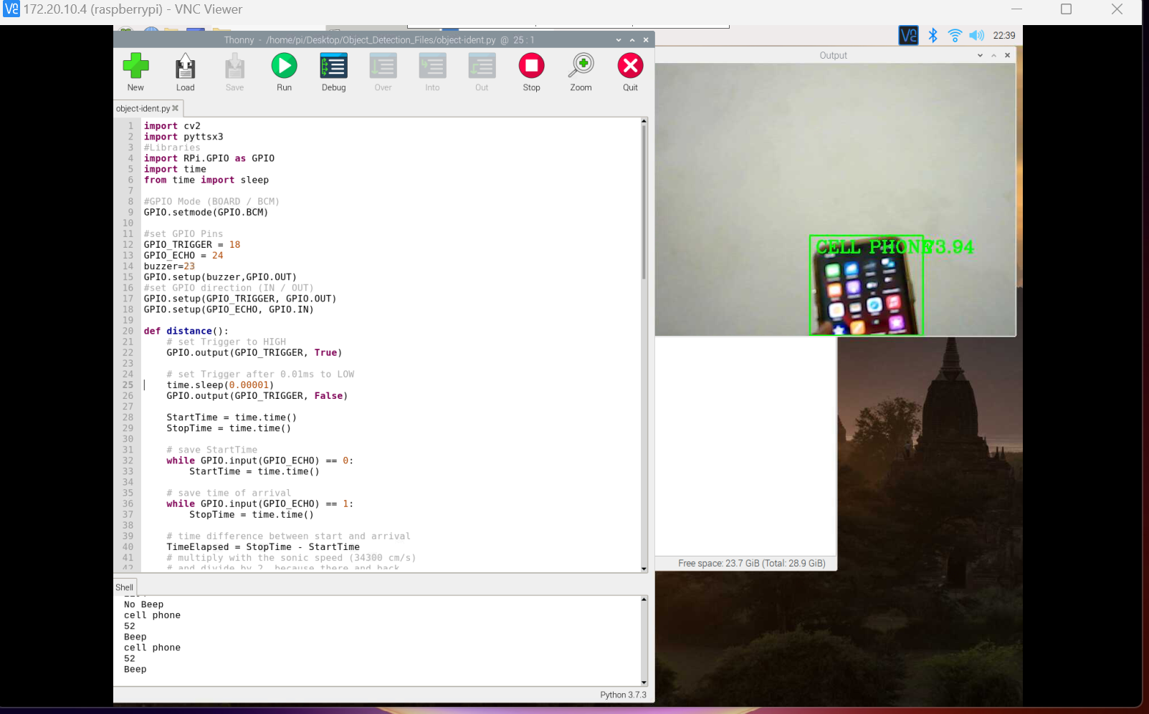
Snapshots
Output of Image Recognition

